Slide 1

Recommendation System for Residential Area (RSRA)

Slide 2
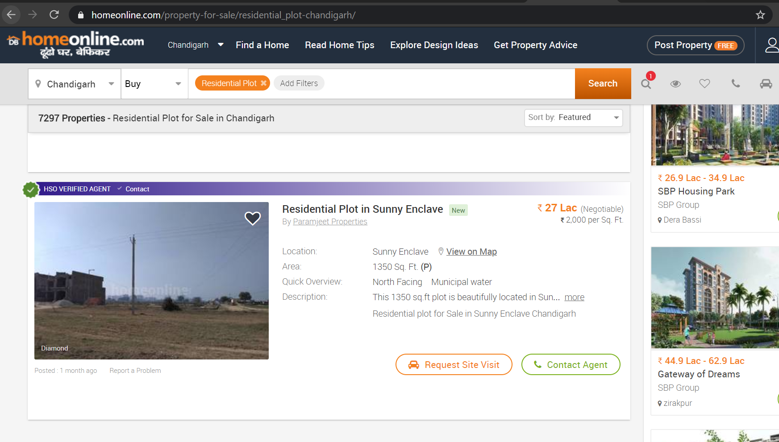
Typical website about residential properties
We usually find
Just show the price.
Area of the property.
A good description by seller.
Few pictures of site.
But it doesn’t tell us who it is suited for?

Slide 3
R.S.R.A.
Make your decision based on correct data.
Need expert opinion just the data from RSRA to an expert.
RSRA is an evolving system with more resources it going to be automated.
RSRA is envisioned on - “Specific client Specific needs”.
World is dynamic so should be our recommendations.

Slide 4
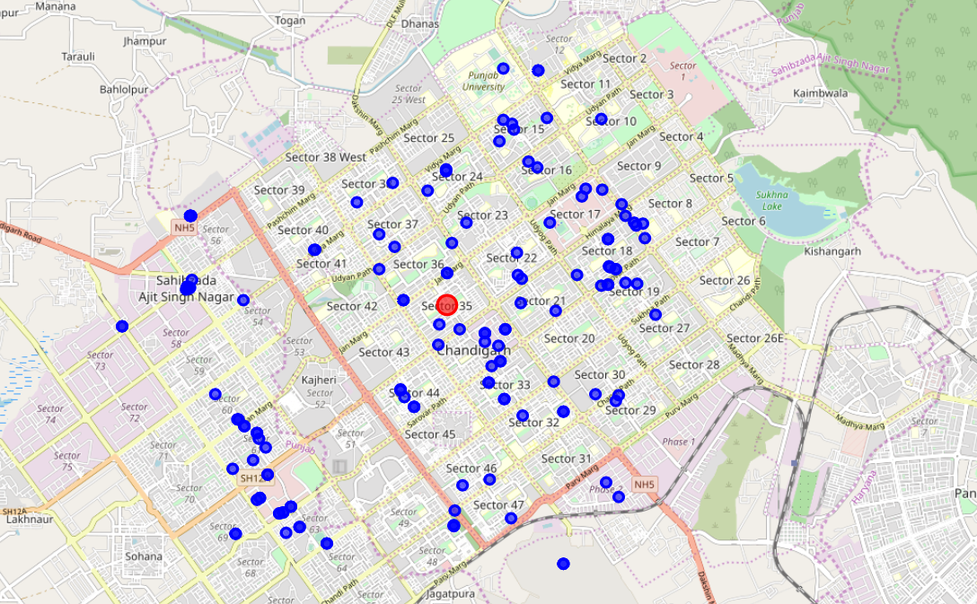
Have a birds eye view of the site

Slide 5
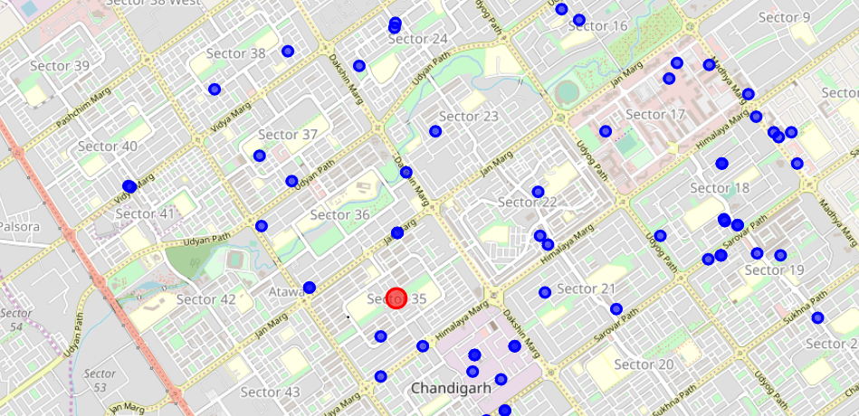
Zoom in like never before

Slide 6
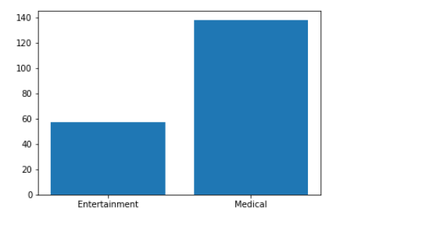
Data simplified with Bars Raised

Slide 7
Come join us and lets revolutionize the way real estate serves its client…

